Slide 1

Products for developing composites

Slide 2
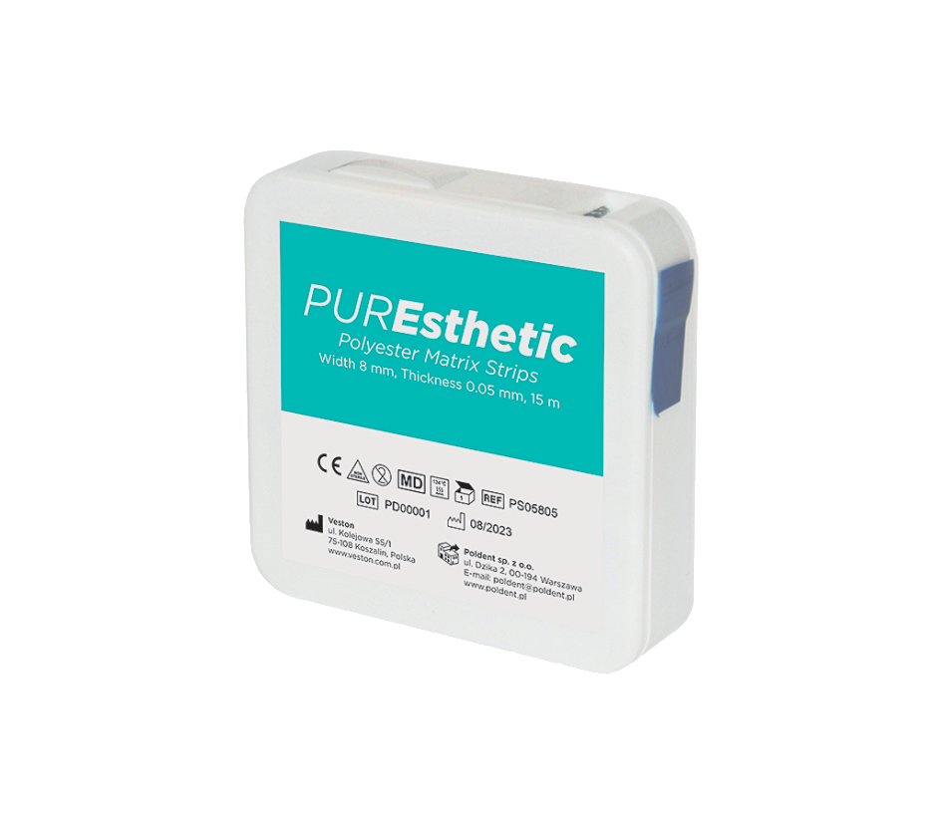
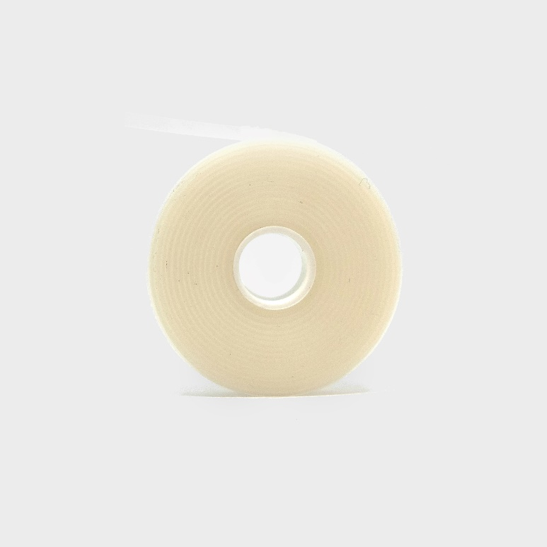

PUREsthetic Polyester Matrix Strips
Smooth Polyester Tape
The tape is designed for shaping composite fillings capable of photopolymerization in Class II cavity fillings. The high smoothness of the tape's surface ensures that the filling does not adhere to the tape.
PS05805 PUREsthetic Polyester Matrix Strips
Width 8 mm, thickness 0.005 mm, length: 15 meters.

Slide 3
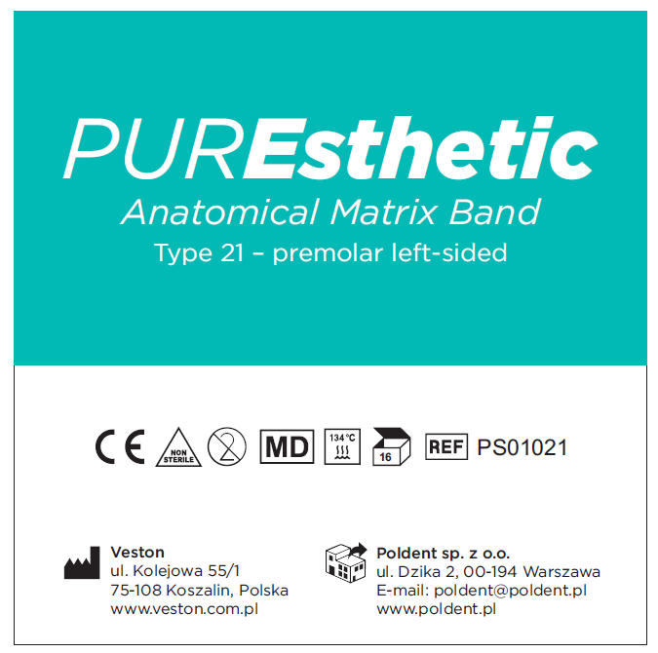
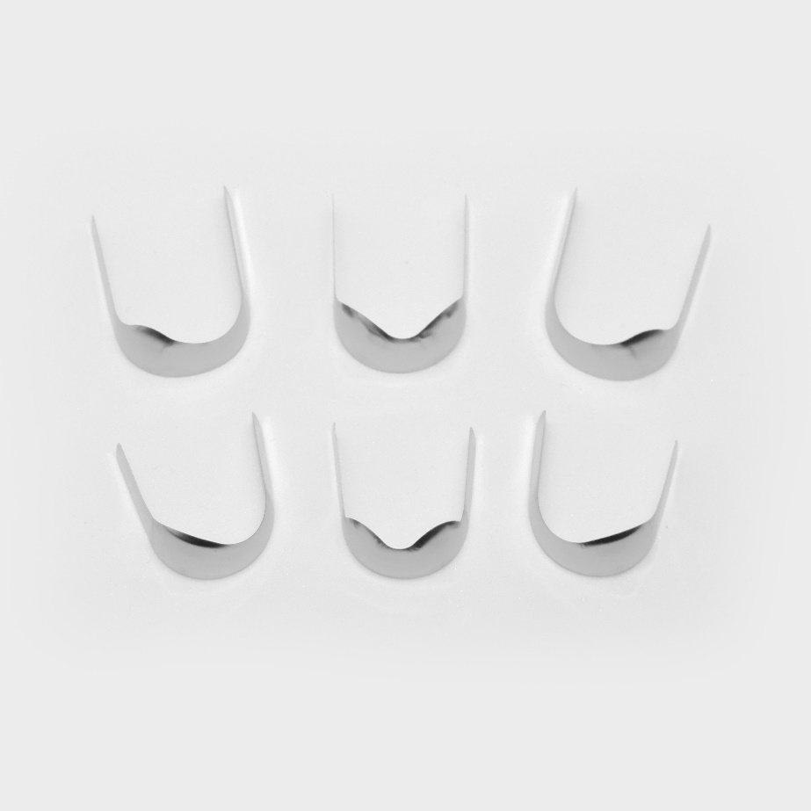
PUREsthetic Anatomical Matrix Band
Strips made of stainless steel intended for making class II restorations. The shape of the strip improves the anatomical adaptation and the point of contact with the reconstruction.
produced in 6 designs:
  type 21 (premolar left-sided),
  type 22 (premolar right-sided),
  type 28 (premolar on both sides),
  type 23 (molar left-sided),
  type 24 (molar right-sided),
  type 29 (molar on both sides),
thickness 0,05 mm,
package contains 16 pieces of strips,
very high smoothness of the strip surface,
disposable, non-sterile product.

Slide 4
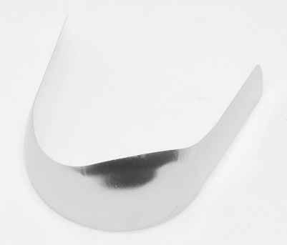
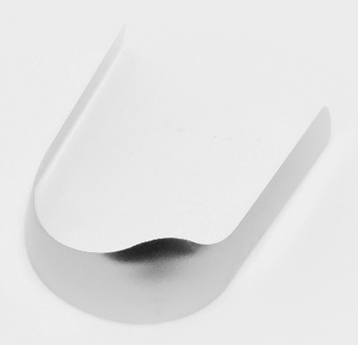


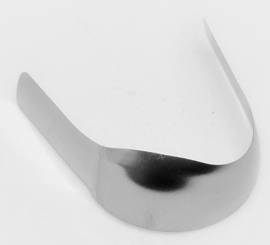

PUREsthetic Anatomical Matrix Band
Type 21 – premolar left-sided PS01021 | Type 23 – molar left-sided PS01023
Type 28 – premolar on both sides PS01028 | Type 29 – molar on both sides PS01029
Type 22 – premolar right-sided PS01022 | Type 24 – molar right-sided PS01024

Slide 5
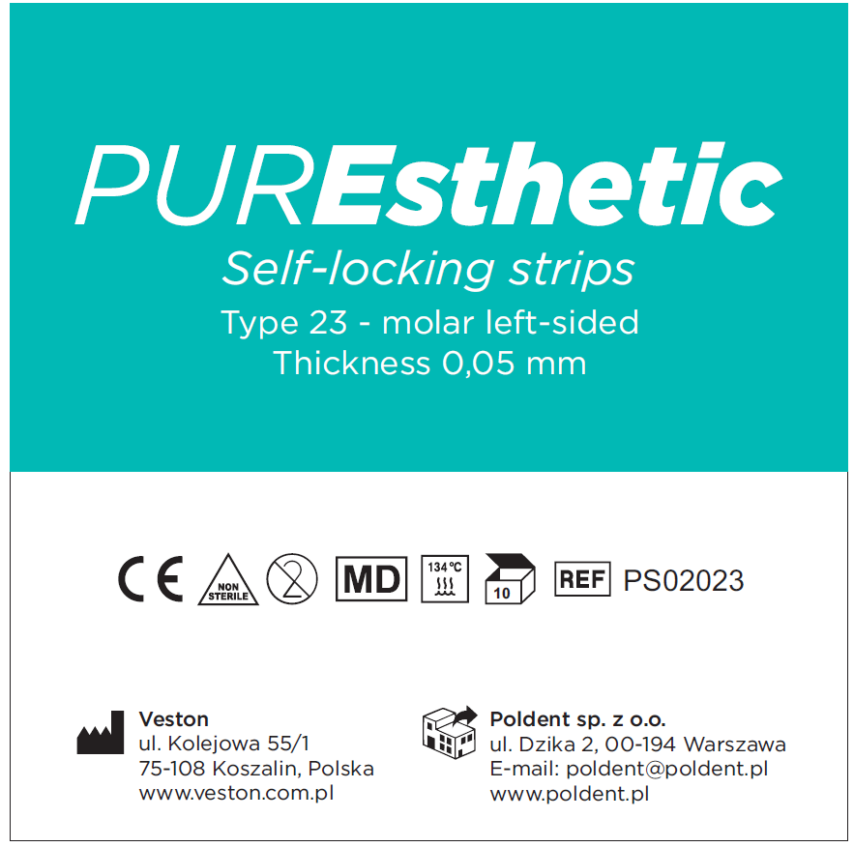
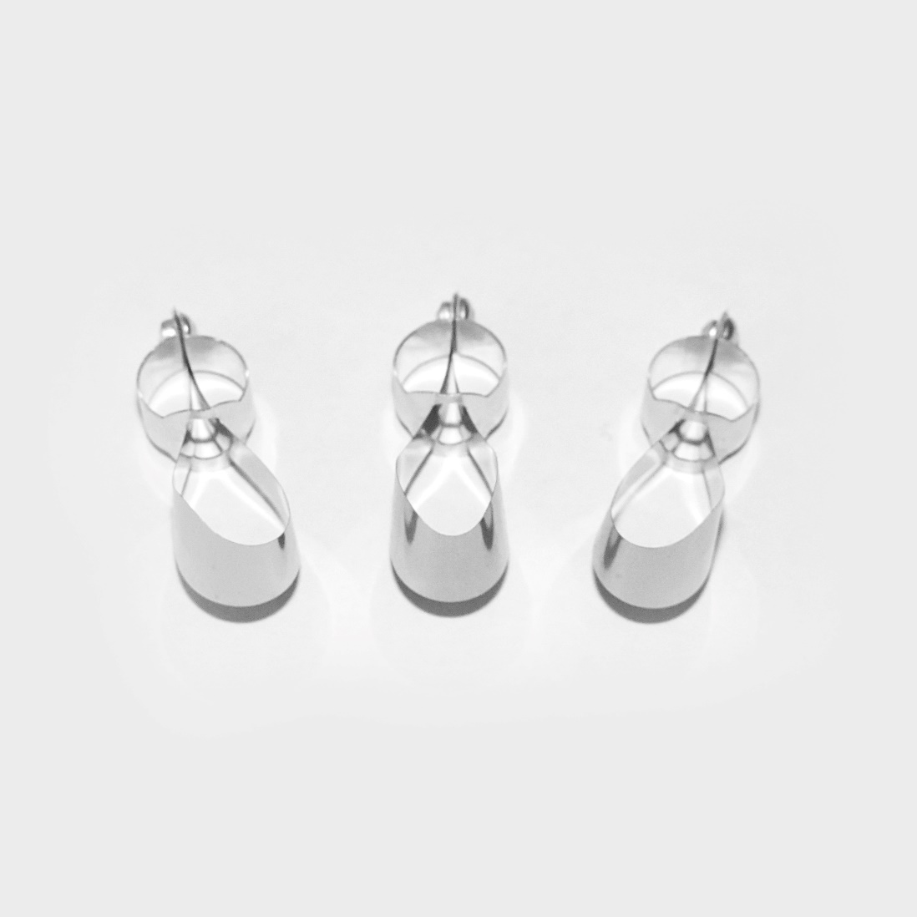
PUREsthetic Self-locking strips
Self-locking strips intended for restoration of class II cavities in molar teeth. The use of a cable tie does not require the use of a mold, which significantly reduces the time of the procedure. The self-locking system allows adjustment depending on the size of the tooth.
produced in 3 designs:
  type 23 (molar left-sided),
  type 24 (molar right-sided),
  type 29 (molar on both sides),
thickness 0,05 mm.
package contains 10 strips,
disposable, non-sterile product.

Slide 6
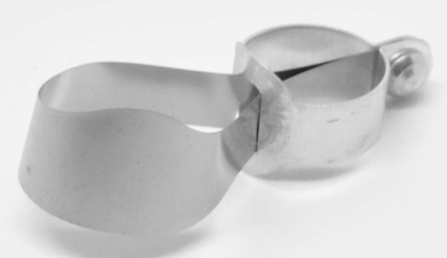
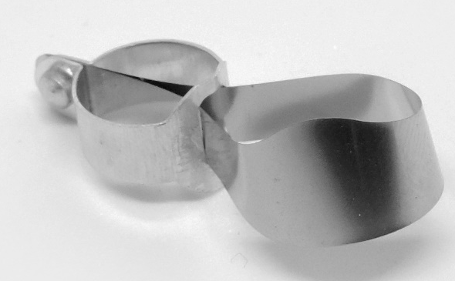
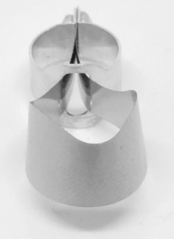
PUREsthetic Self-locking strips
Type 23 – molar left-sided PS02023
Type 24 – molar right-sided PS02024
Type 29 – molar on both sides PS02029

Slide 7
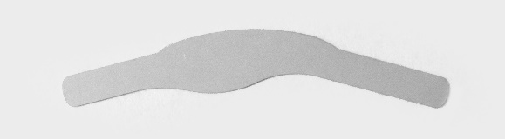
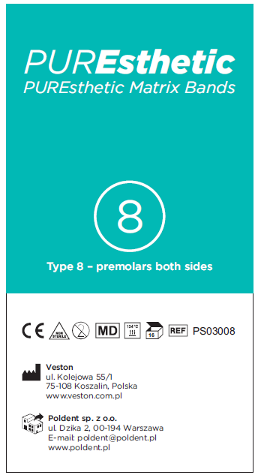

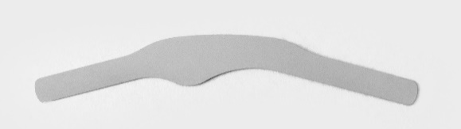
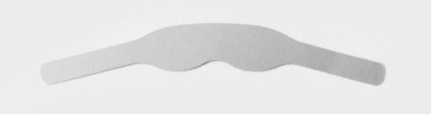
PUREsthetic Matrix Bands
Profiled strips made of stainless steel in 4 different shapes intended for making class II restorations and for use with photopolymerizable resins.
produced in 4 designs:
  type 8 (premolars on both sides),
  type 9 (molars on both sides),
  type 12 (premolars one side),
  type 13 (molars one side),
thickness 0,05 mm,
package contains 16 pieces of strips,
very high smoothness of the strip surface,
disposable, non-sterile product.

Slide 8




PUREsthetic Matrix Bands
PS03008 Type 8 – premolars on both sides
PS03009 Type 9 – molars on both sides
PS03012 Type 12 – premolars one side
PS03013 Type 13 – molars one side

Slide 9
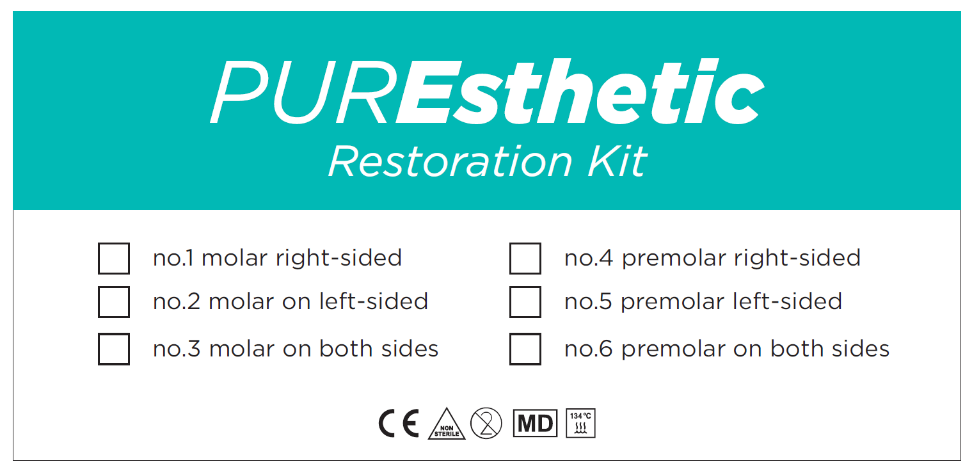
PURESTHETIC RESTORATION KITS

Slide 10
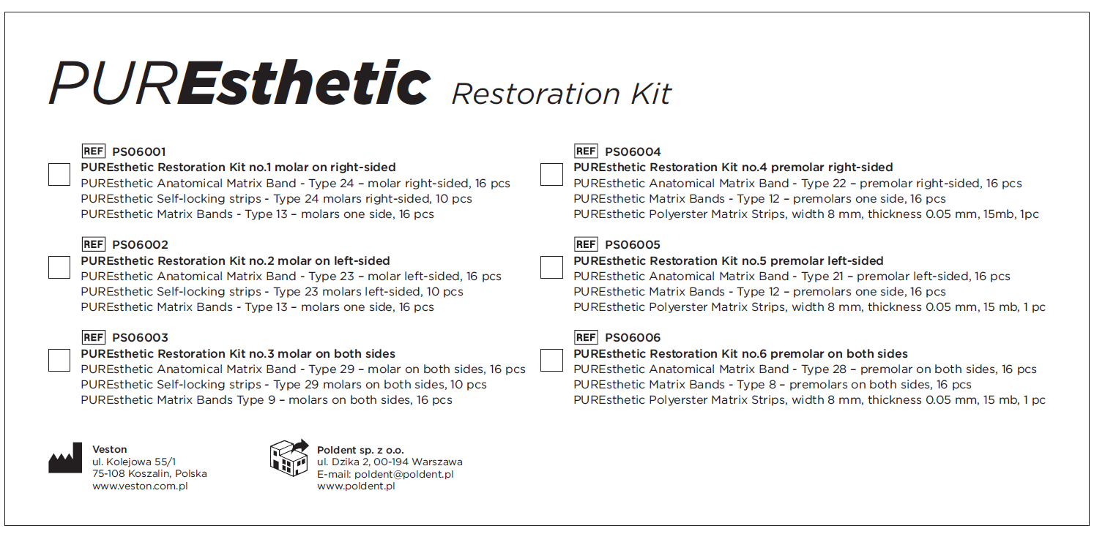
PURESTHETIC RESTORATION KITS

Slide 11
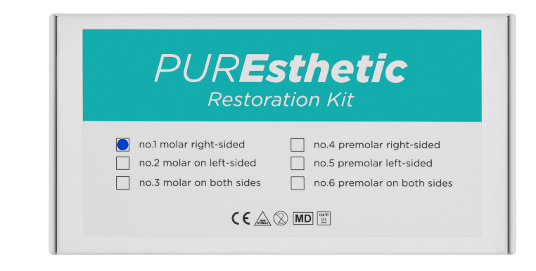
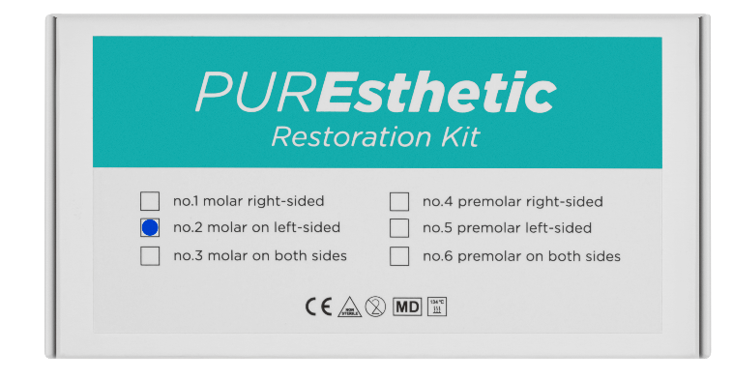


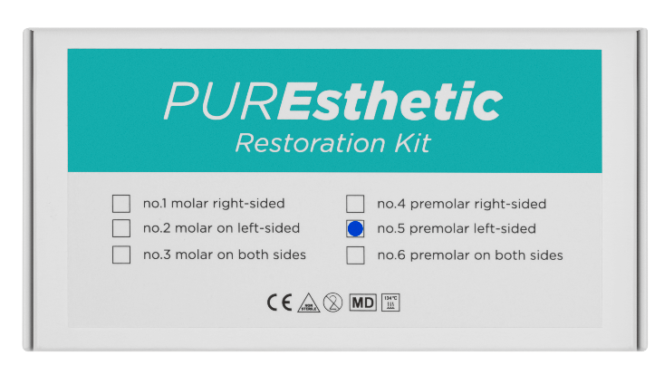

PURESTHETIC RESTORATION KITS
6 sets for restoring Class II cavities intended for various areas of the oral cavity.
3 sets for molars:
3 sets for premolars:

Slide 12
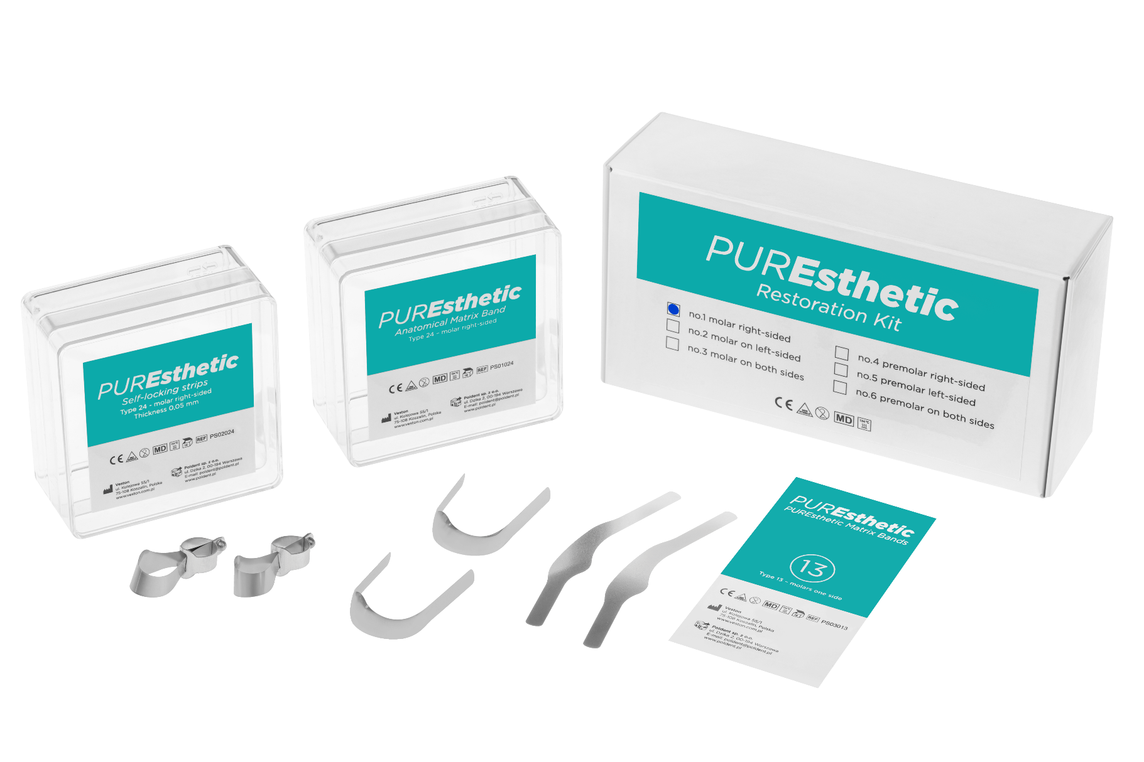
PUREsthetic Restoration Kit no. 1 molar on right-sided
CODE PS06001 | PUREsthetic Restoration Kit no.1 molar on right-sided PUREsthetic Anatomical Matrix Band – type 24, molar right-sided, 16 pcs PUREsthetic Self-locking strips – type 24, molars right-sided, 10 pcs PUREsthetic Matrix Bands – type 13, molars one side, 16 pcs

Slide 13



PUREsthetic Restoration Kit no. 1 molar on right-sided
Set for restoring class II cavities intended for right-sided molar teeth.
Kit contains:
PUREsthetic Anatomical Matrix Band – type 24, molar right-sided, 16 pcs
PUREsthetic Self-locking strips – type 24, molars right-sided, 10 pcs
PUREsthetic Matrix Bands – type 13, molars one side, 16 pcs

Slide 14

PUREsthetic Restoration Kit no. 2 molar on left-sided
CODE PS06002 | PUREsthetic Restoration Kit no. 2 molar on left-sided PUREsthetic Anatomical Matrix Band – type 23, molar left-sided, 16 pcs PUREsthetic Self-locking strips – type 23, molars left-sided, 10 pcs PUREsthetic Matrix Bands – type 13, molars one side, 16 pcs

Slide 15



PUREsthetic Restoration Kit no. 2 molar on left-sided
Set for restoring class II cavities intended for left-sided molar teeth.
Kit contains:
PUREsthetic Anatomical Matrix Band – type 23, molar left-sided, 16 pcs
PUREsthetic Self-locking strips – type 23, molars left-sided, 10 pcs
PUREsthetic Matrix Bands – type 13, molars one side, 16 pcs

Slide 16

PUREsthetic Restoration Kit no. 3 molar on both sides
CODE PS06003 | PUREsthetic Restoration Kit no.3 molar on both sides PUREsthetic Anatomical Matrix Band – type 29, molar on both sides, 16 pcs PUREsthetic Self-locking strips – type 29, molars on both sides, 10 pcs PUREsthetic Matrix Bands – type 9, molars on both sides, 16 pcs

Slide 17



PUREsthetic Restoration Kit no. 3 molar on both sides
Set for restoring class II cavities intended for both sides molar teeth.
Kit contains:
PUREsthetic Anatomical Matrix Band – type 29, molars on both sides, 16 pcs
PUREsthetic Self-locking strips – type 29, molars on both sides, 10 pcs
PUREsthetic Matrix Bands – type 9, molars on both sides, 16 pcs

Slide 18
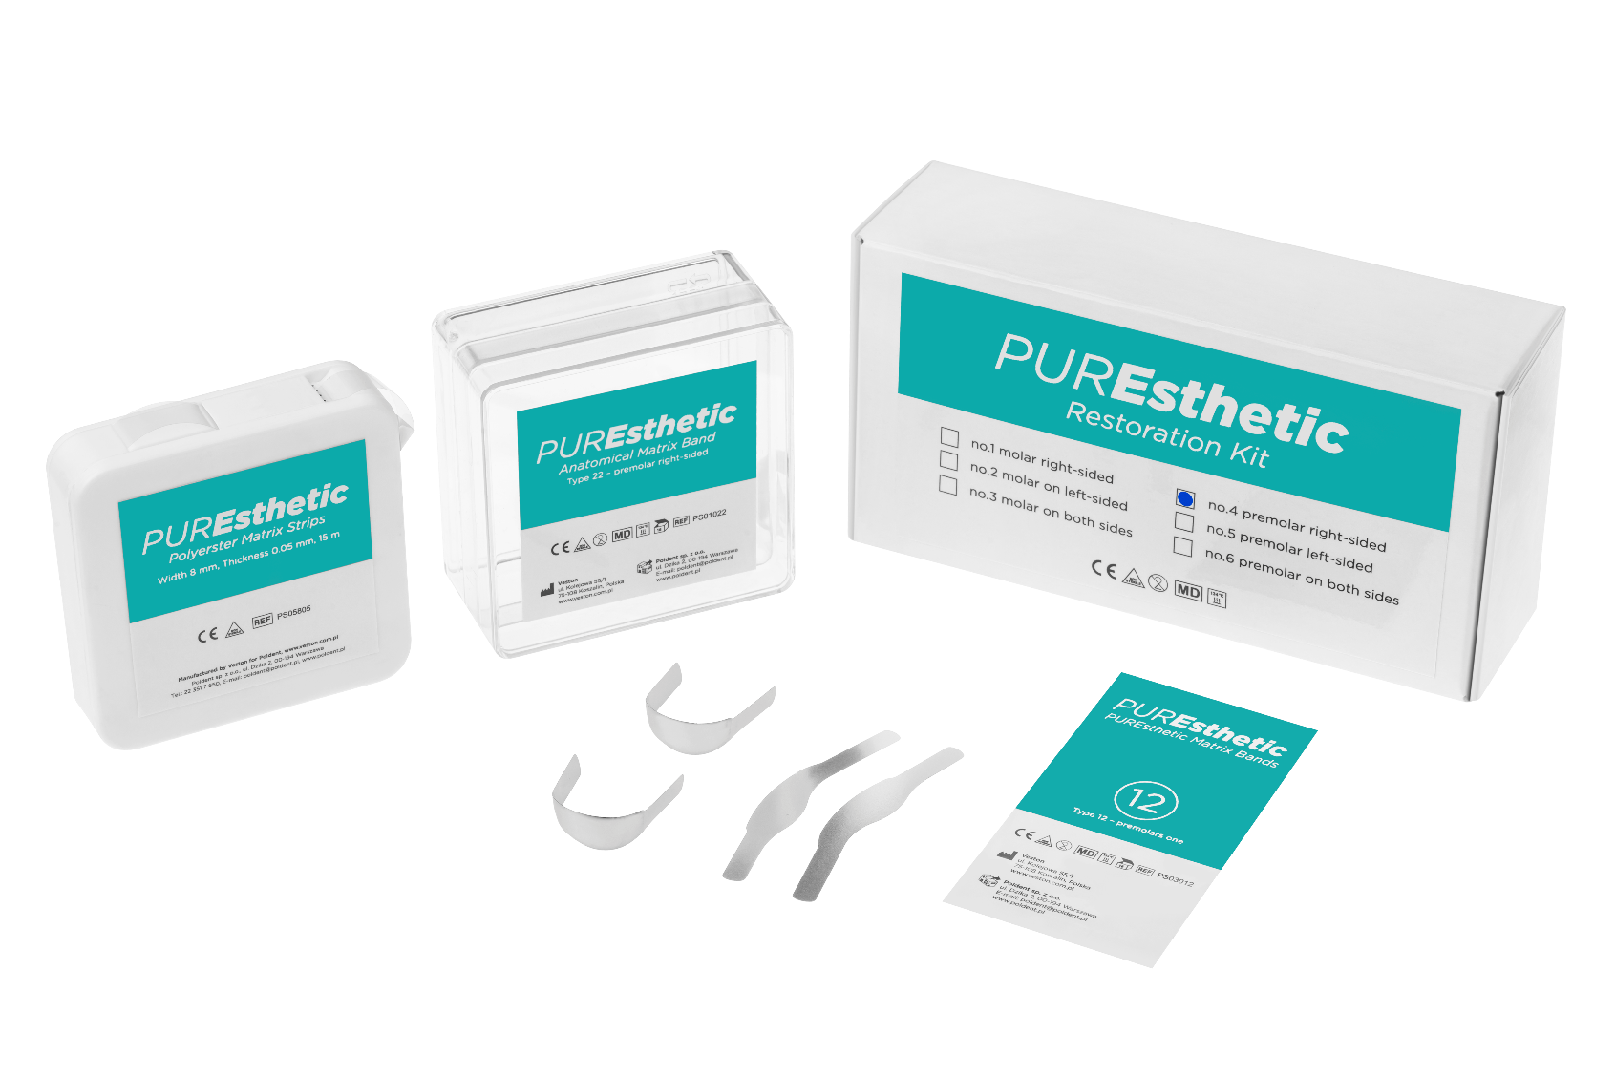
PUREsthetic Restoration Kit no. 4 premolar right-sided
CODE PS06004 | PUREsthetic Restoration Kit no.4 premolar right-sided PUREsthetic Anatomical Matrix Band – type 22, premolar right-sided, 16 pcs PUREsthetic Matrix Bands – type 12, premolars one side, 16 pcs PUREsthetic Polyester Matrix Strips – width 8 mm, thickness 0,05 mm, 15 mb, 1 pc

Slide 19


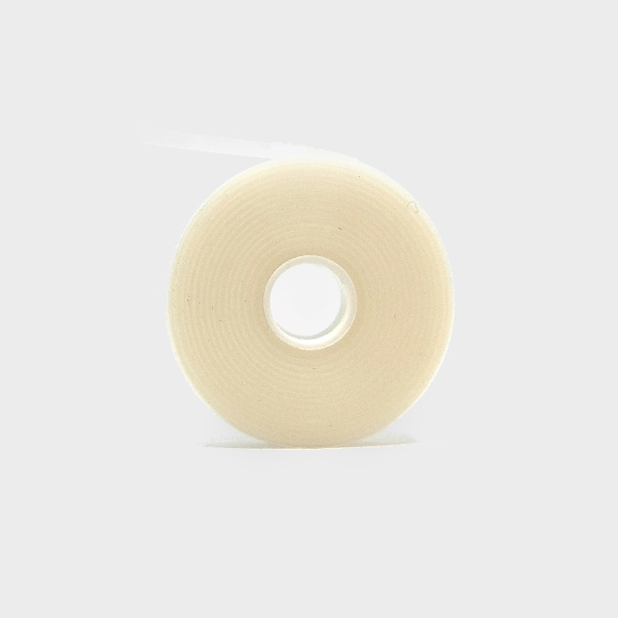
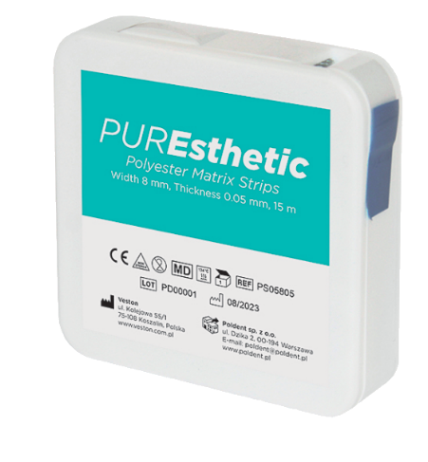
PUREsthetic Restoration Kit no. 4 premolar right-sided
Set for restoring class II cavities intended for right-sided premolar teeth.
Kit contains:
PUREsthetic Anatomical Matrix Band – type 22, premolar right-sided, 16 pcs
PUREsthetic Matrix Bands – type 12, premolars one side, 16 pcs
PUREsthetic Polyester Matrix Strips – width 8 mm, thickness 0,05 mm, 15 mb, 1 pc

Slide 20
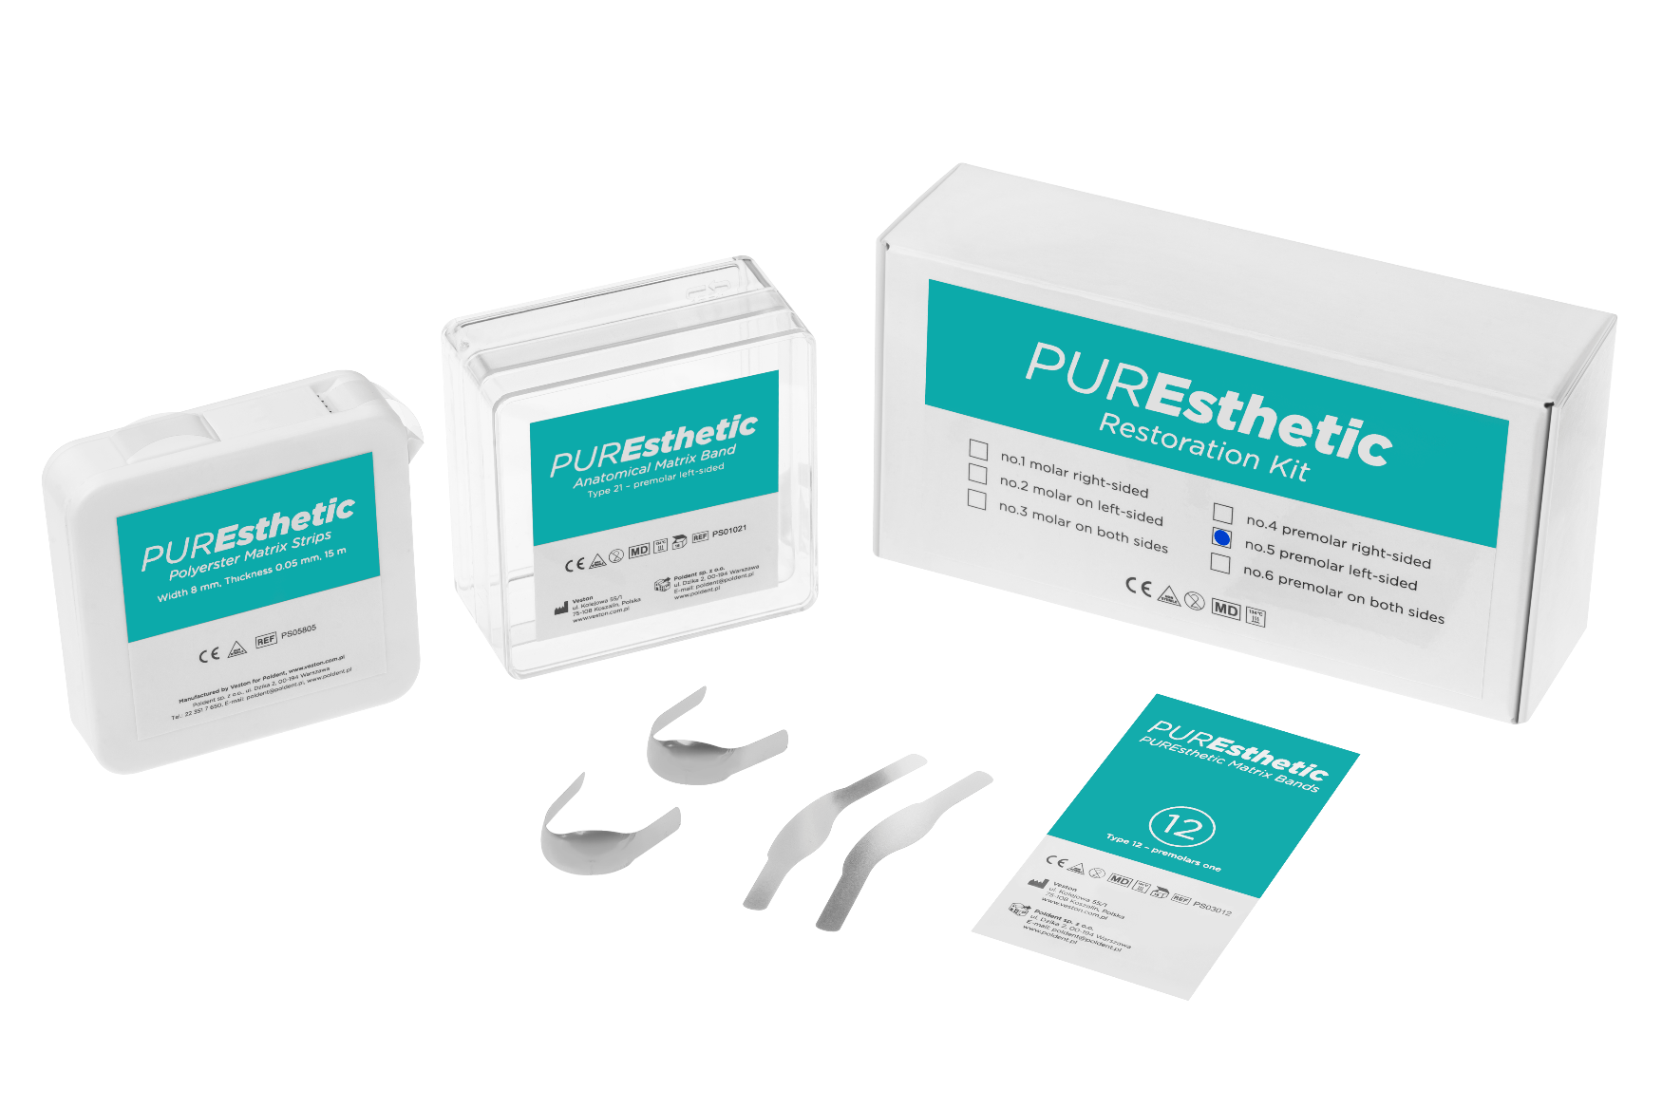
PUREsthetic Restoration Kit no. 5 premolar left-sided
CODE PS06005 | PUREsthetic Restoration Kit no.5 premolar left-sided PUREsthetic Anatomical Matrix Band – type 21, premolar left-sided, 16 pcs PUREsthetic Matrix Bands – type 12, premolars one side, 16 pcs PUREsthetic Polyester Matrix Strips – width 8 mm, thickness 0,05 mm, 15 mb, 1 pc

Slide 21
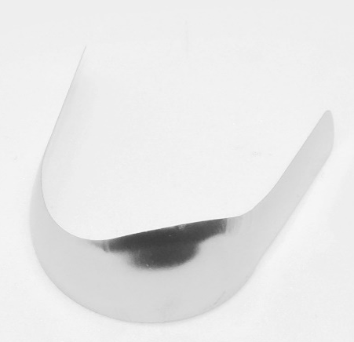

PUREsthetic Restoration Kit no. 5 premolar left-sided
Set for restoring class II cavities intended for left-sided premolar teeth.
Kit contains:
PUREsthetic Anatomical Matrix Band – type 21, premolar left-sided, 16 pcs
PUREsthetic Matrix Bands – type 12, premolars one side, 16 pcs
PUREsthetic Polyester Matrix Strips – width 8 mm, thickness 0,05 mm, 15 mb, 1 pc

Slide 22

PUREsthetic Restoration Kit no. 6 premolar on both sides
CODE PS06006 | PUREsthetic Restoration Kit no.6 premolar on both sides PUREsthetic Anatomical Matrix Band – type 28, premolar on both sides, 16 pcs PUREsthetic Matrix Bands – type 8, premolars on both sides, 16 pcs PUREsthetic Polyester Matrix Strips – width 8 mm, thickness 0,05 mm, 15 mb, 1 pc

Slide 23


PUREsthetic Restoration Kit no. 6 premolar on both sides
Set for restoring class II cavities intended for both sides premolar teeth.
Kit contains:
PUREsthetic Anatomical Matrix Band – type 28, premolar on both sides, 16 pcs
PUREsthetic Matrix Bands – type 8, premolars on both sides, 16 pcs
PUREsthetic Polyester Matrix Strips – width 8 mm, thickness 0,05 mm, 15 mb, 1 pc

Slide 24
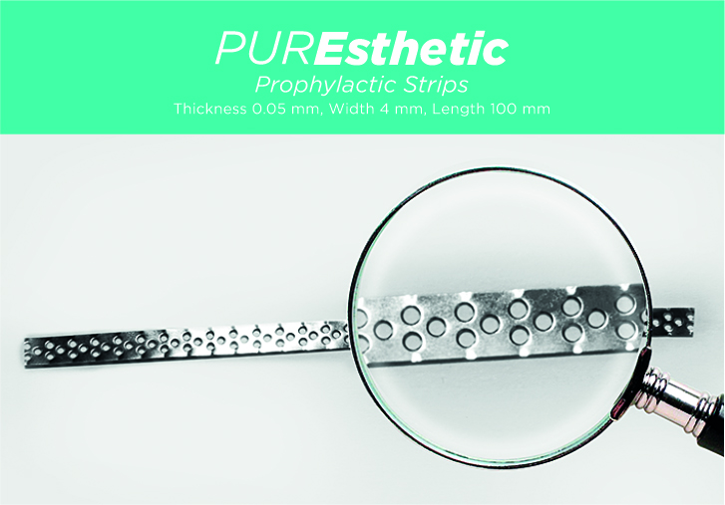
PUREsthetic Prophylactic Strips
Prophylactic Strips
Perforated strips are an essential aid in the prevention of removing dental plaque residues, tartar, and stains from interdental surfaces without grinding and damaging tooth enamel.
PS04000 PUREsthetic Prophylactic Strips Thickness 0.05 mm, width 4 mm, length 100 mm, 10 pieces.

